Slide 1

Unit 2 Family
家庭

Slide 2
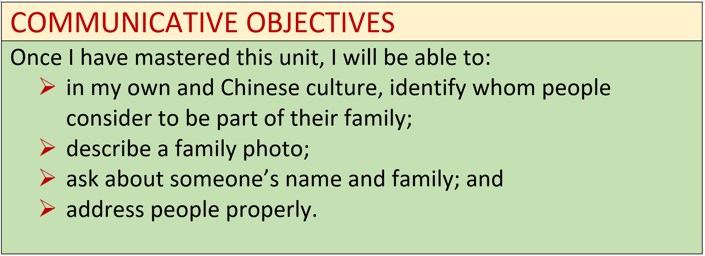

Slide 3
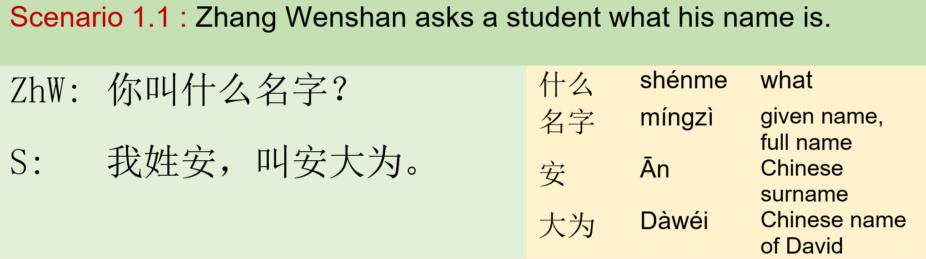

Module I: Inquire Names 模块一：问姓名

Slide 4
Exercise
Communication:
Students pair up; Students ask each other what the other’s name is ; Each pair of student has some vocabulary flash cards Student A asks student B “What words is this?” in CHINESE
Question word: 什么
Q: 你 叫 什么（名字）？
A: 我 叫 安大为。
Drill：
这是什么（字）？

Slide 5
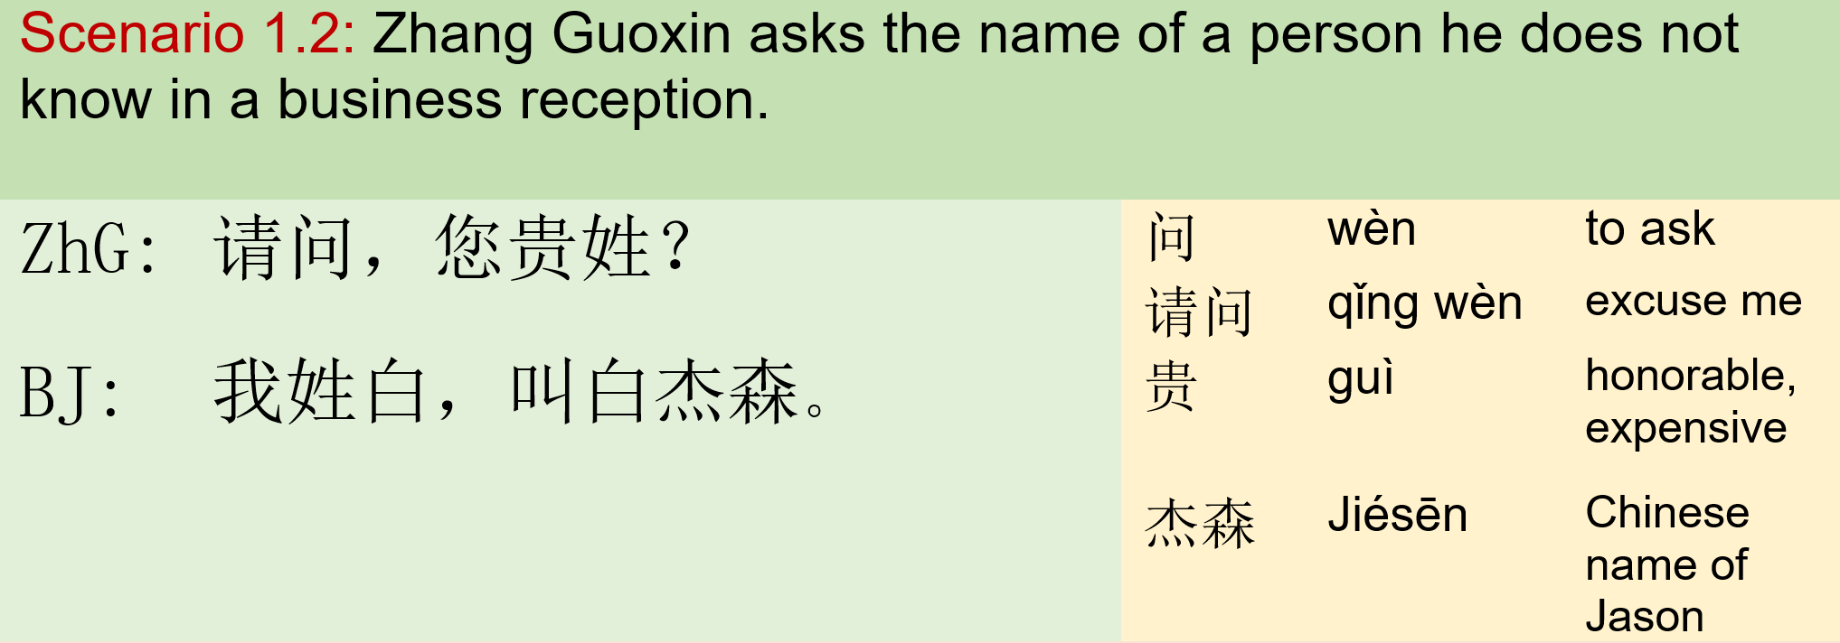
Module I: Inquire Names 模块一：问姓名

Slide 6
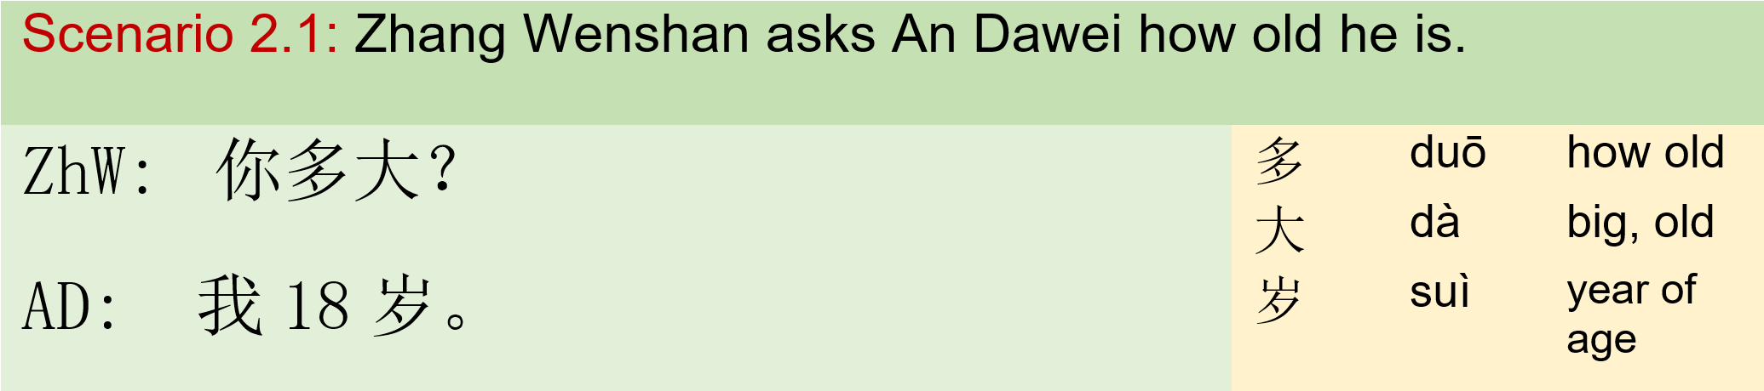
Module II: Inquire Age 模块二：问年龄

Slide 7
Exercise
Communication:
Students pair up. Students ask each other’s age. Students drill the questions on left. Two pairs of students perform the Q&A in front of the class. And the rest students take a note of the ages while listening.
Question word: 多
Q: 你 多 大？
A: 我 岁。
Drill：
你妈妈多大？
你爸爸多大？
李阿姨多大？
张文山多大?
你的孩子多大？

Slide 8
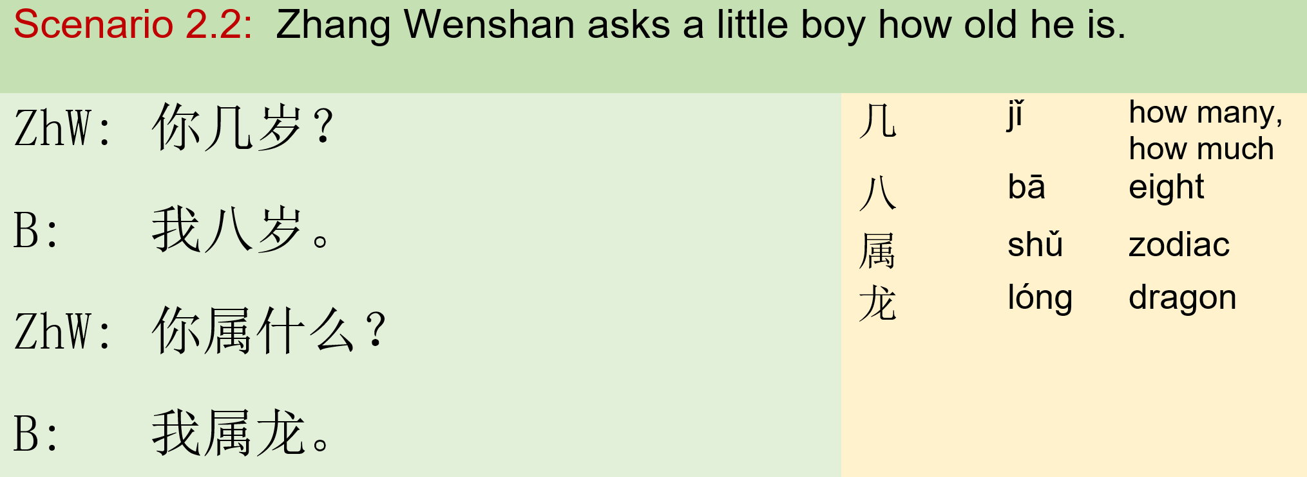
Module II: Inquire Age 模块二：问年龄

Slide 9
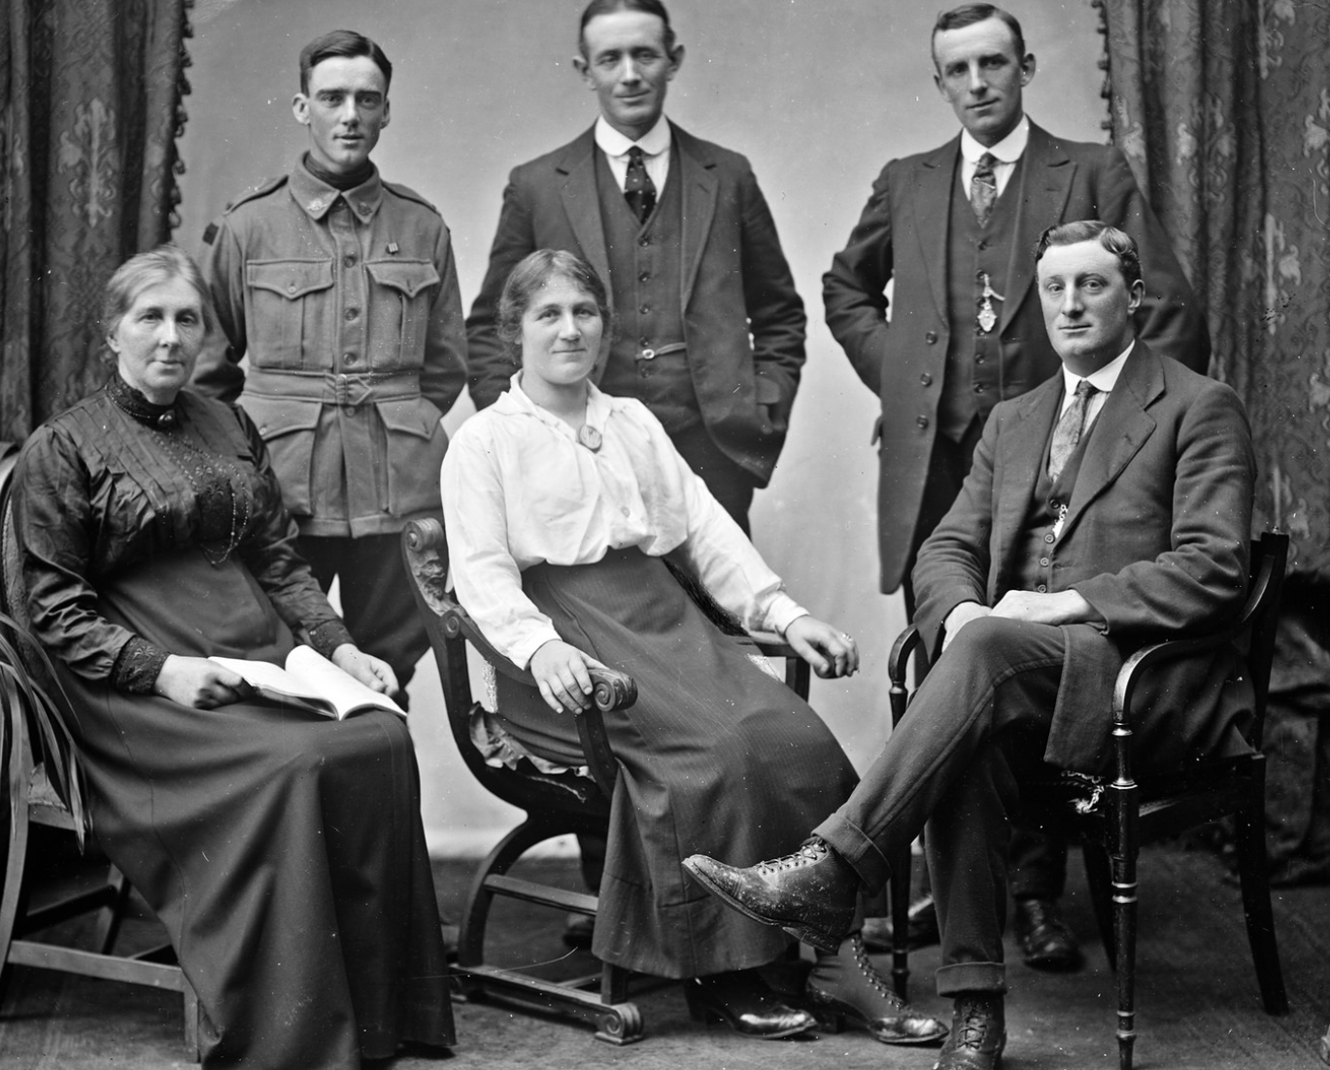
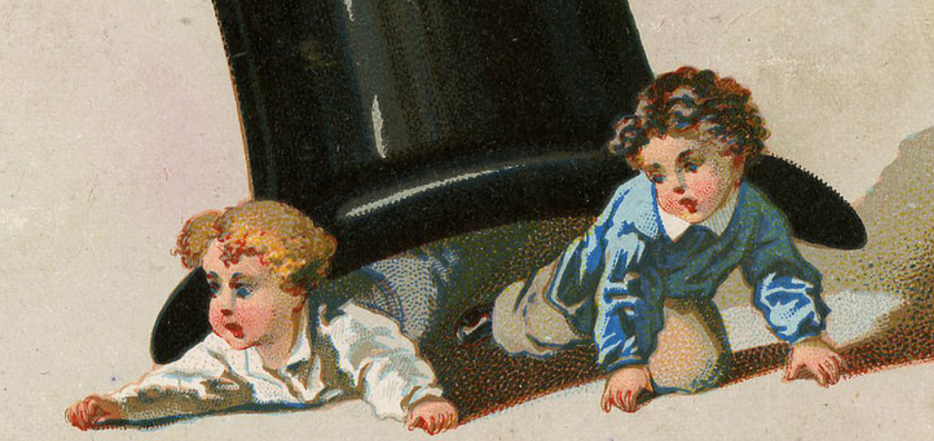
Integration
Communication:
Students pair up. Students ask and answer questions basing on the pictures.
Question word: 几
Q: 你 几 岁？
A: 我 岁。
Drill：
几个？

Slide 10
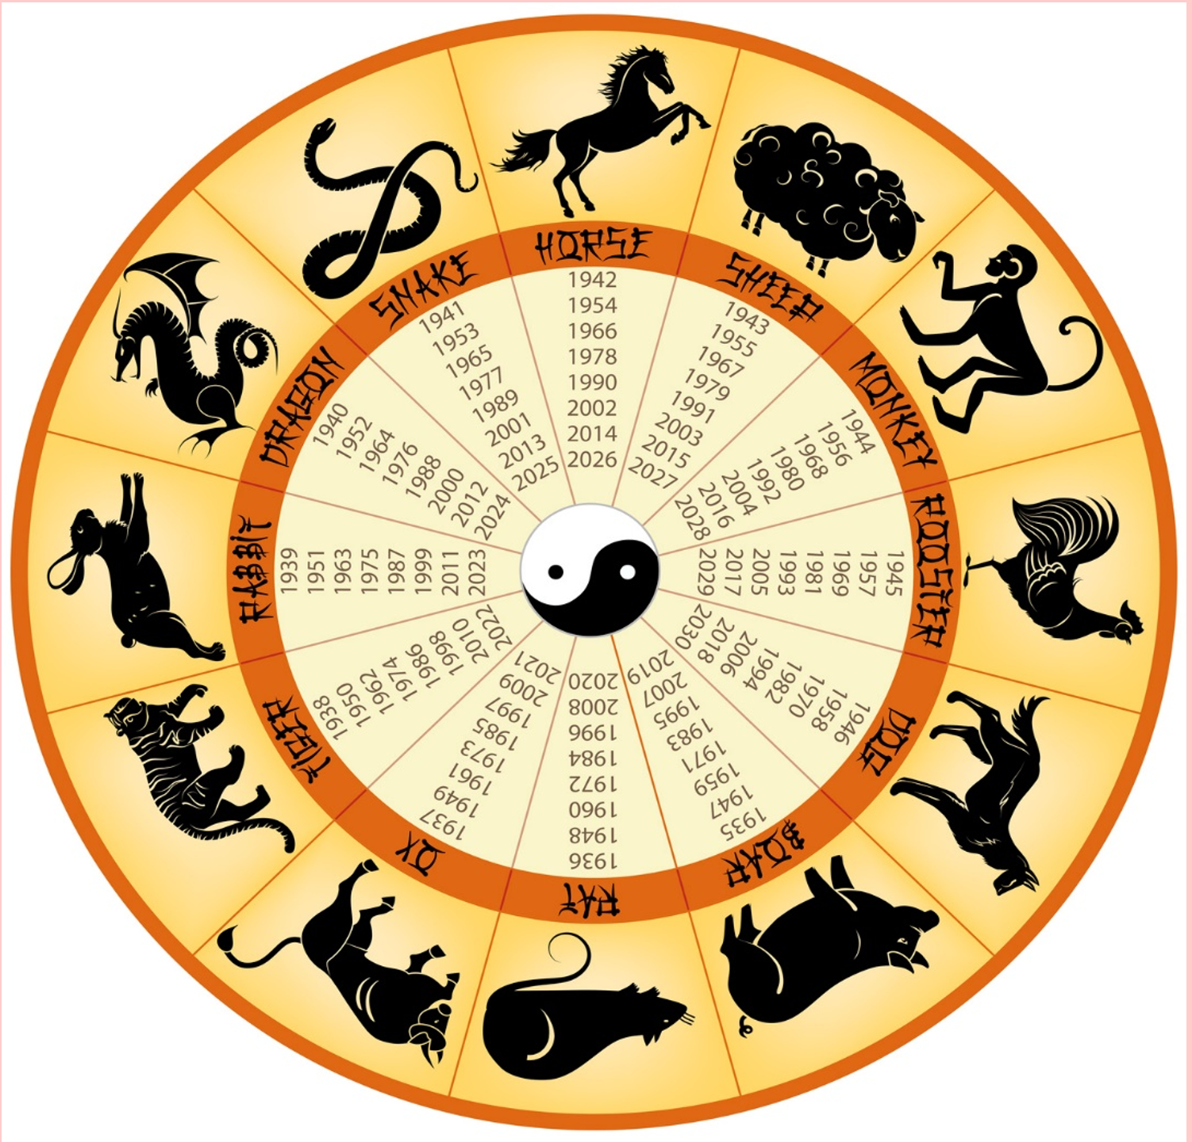
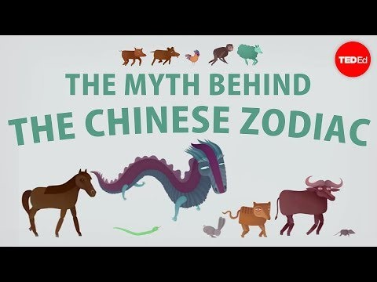
Integration
Literacy: Chinese Zodiac

Slide 11
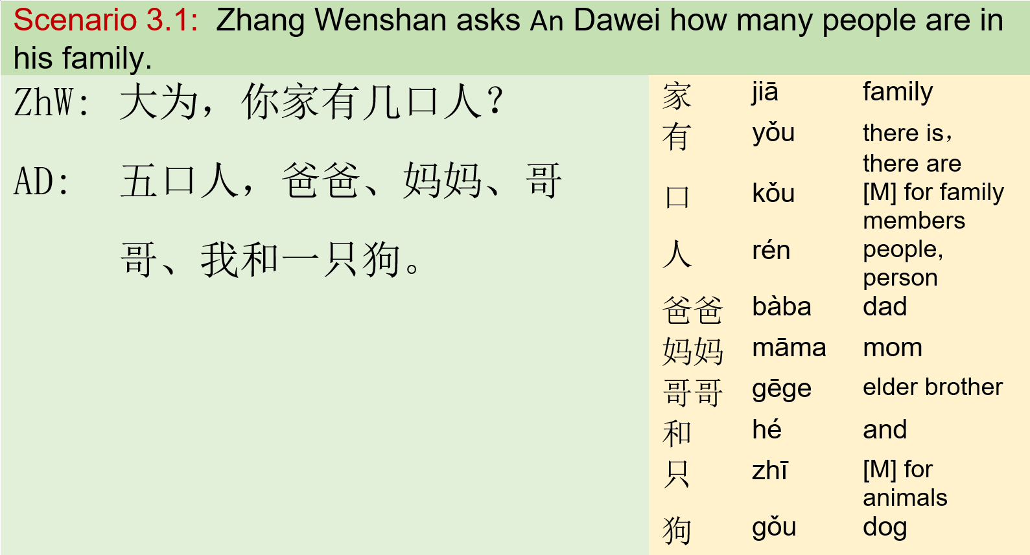
Module III: Inquire Family Member 模块三：问家人

Slide 12
Exercise
有： a verb, can indicate the existence of something in a certain place. The pattern is,
place word + 有 + noun phrase
你家 有 几口人?
(lit. In your family, there are how many people?)
你有几个哥哥？
张阿姨有几个孩子？
你家有几只狗？
COCC有几位中文老师？
这儿有几位病人？
Communication:
Students pair up. Student A reads the questions (on the left) and write down the answer. Student B askes student A the questions(on the left) and write down the numbers he/she hear.

Slide 13
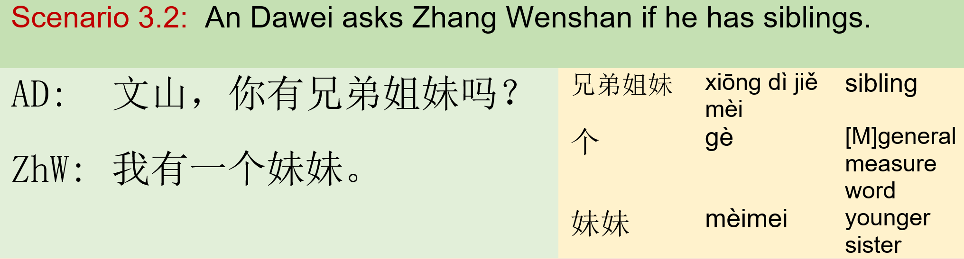
Module III: Inquire Family Member 模块三：问家人

Slide 14
Exercise
Communication:
Students pair up. Student B asks student A the questions (on the left). Student A answer with truth.
有…吗？
你有哥哥吗？你有几个哥哥？
张阿姨有孩子吗？张阿姨有几个孩子？
你家有狗吗？你家有几只狗？
COCC有中文老师吗？有几位？
这儿有病人吗？有几位？
Note: Do NOT use number words in a yes/no question.

Slide 15
Exercise
个， is a measure word. In English, most nouns can be counted directly, i.e., “one dog.” In Chinese a so-called measure word, also called “classifier,” is used between number words (one, two…) ／specifiers (this, that…) and nouns. The pattern is：
Number Word + Measure Word + Noun
一 个 妹妹
(lit. “one younger sister”)
More examples,
一只狗 五口人 三位先生
这位老师 这个妹妹

Slide 16
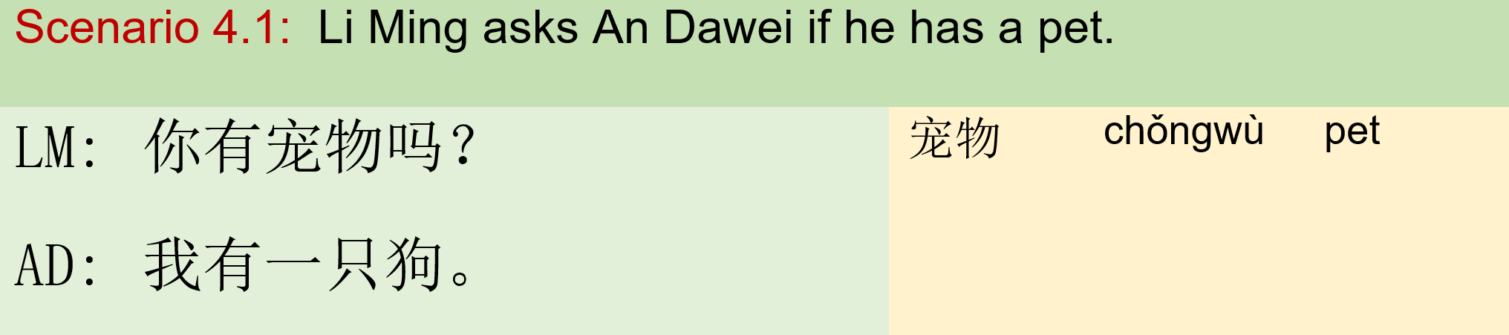
Module IV: Inquire Pets 模块四：问宠物

Slide 17
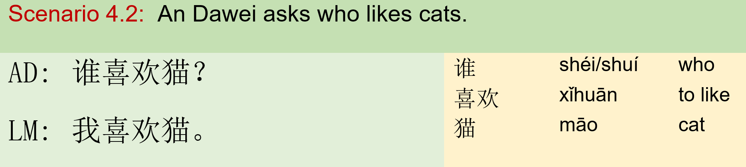
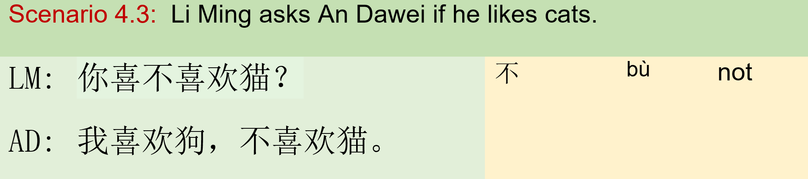
Module IV: Inquire Pets 模块四：问宠物

Slide 18
Integration
Communication:
Conduct a survey and find out: 1. How many people in the class have pets? 2. What is the most popular pet? 3. How many people in the class have cats? 4. How many people in the class have dogs?
你有宠物吗？
你有狗吗？
你有猫吗？
你有几只X?
你最喜欢什么动物？
你喜欢狗吗？
你喜欢猫吗？

Slide 19
Integration:
Interview: X’s family
member | surname | Full name | age | zodiac | pets | Favorite animals
Students create interview questions list.
Students pair up.
Student A interviews student B with the questions.
Both of the students collaborate to fill out the chart.
Student A presents student B’s family members.

